Slide 1

Topic: E- Commerce Website
Panellist:
Dr. Ajay Kumar
Submitted By:
Asmita Prabhakar (190025)
BTech CSE 3rd year

Slide 2
TRAVEL WebSIte
We believe in making our customers happy by helping them in taking back good and wonderful memories from trip

Slide 3
INTRODUCTION
This website is Complete Responsive Travel Website . A responsive website will automatically adjust for different screen sizes and viewports according to user’s choice.
This website is basically a travel website which has some special types of travel packages like trips to Egypt, Paris, Mumbai etc. offered to their customers and along with this it tries to improve itself by taking customer’s review.

Slide 4
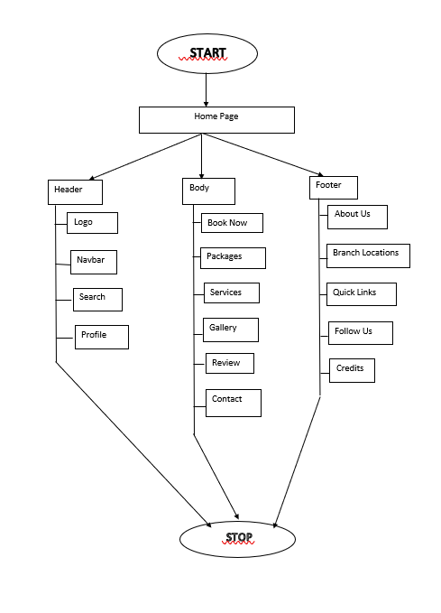
System Flowchart

Slide 5
IMPLEMENTATION
We have used various technologies for our frontend like CSS , HTML and JS.
Here we have used Html for basic structure of our web page , css for designing and java script to add functionality.
It has three section Header, Body and Footer .
In Header part there is logo and navbar.
Body has six section Home page which behaves like a cover of our travel website , Book now section takes in info about the dates and places you are planning your travel to. . In packages section you find packages for different places . In gallery section there is some pictures of different places , Review section helps us to improve ourselves by taking customer review about our packages and services . Contact section helps the customer to connect to us for any type of query.
Footer section contains the copyright link so that no one can misuse the name of your site.

Slide 6
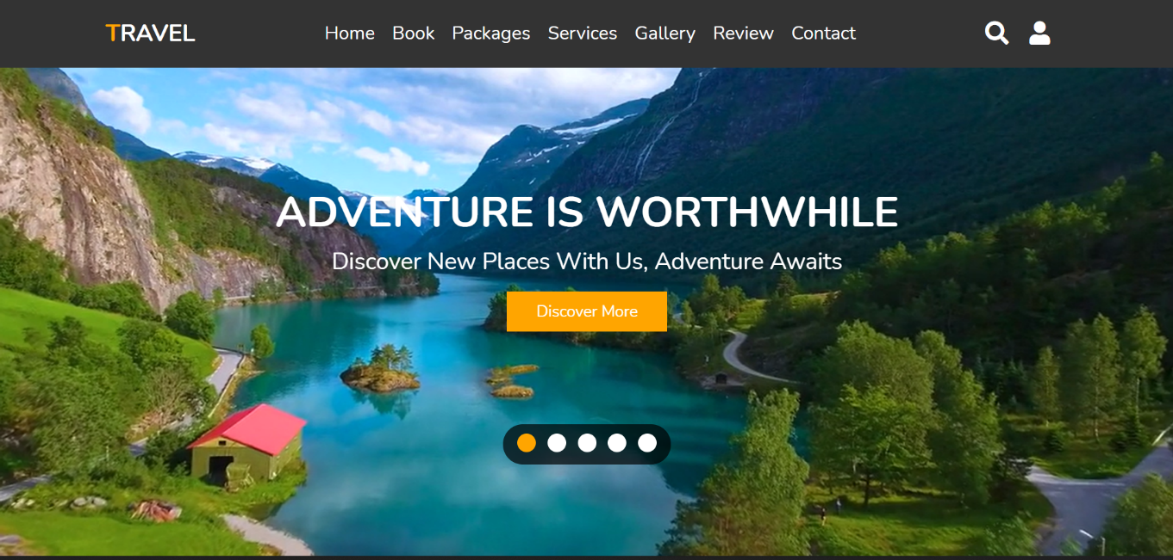
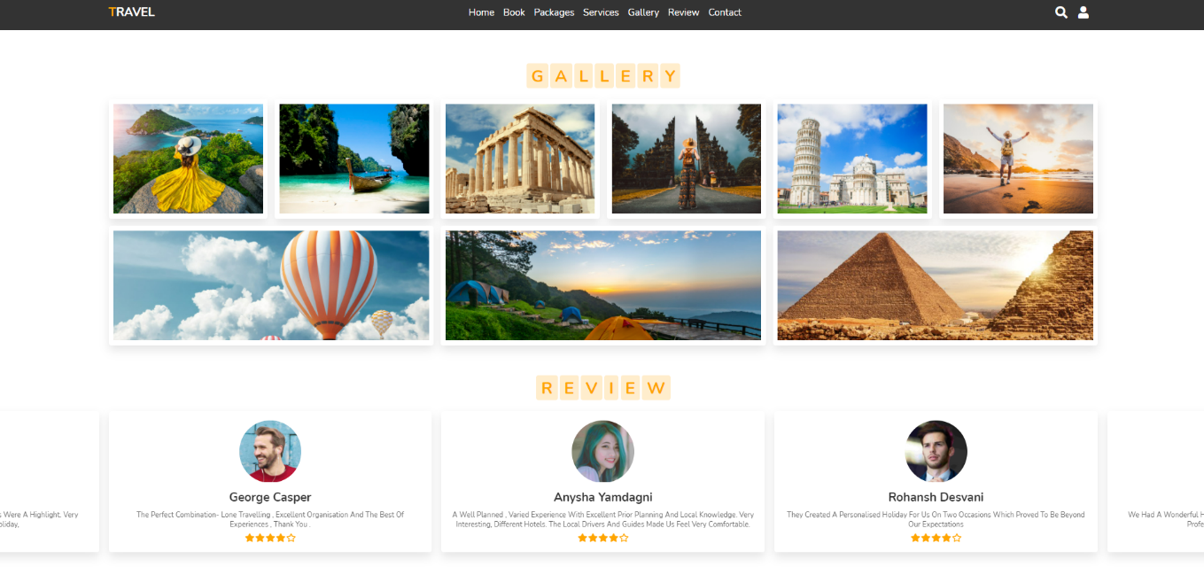
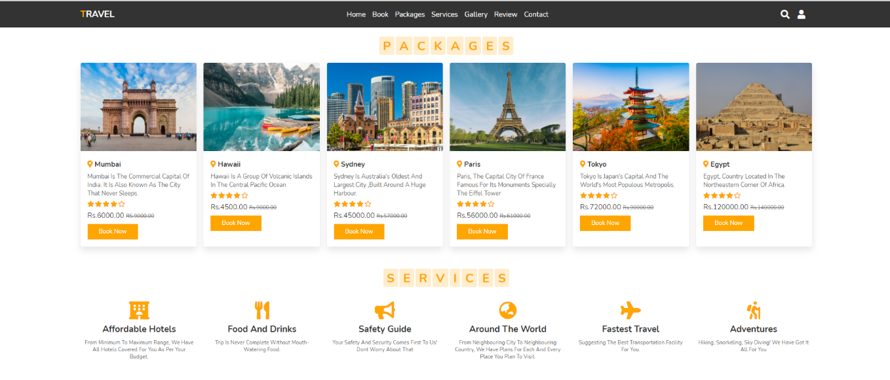
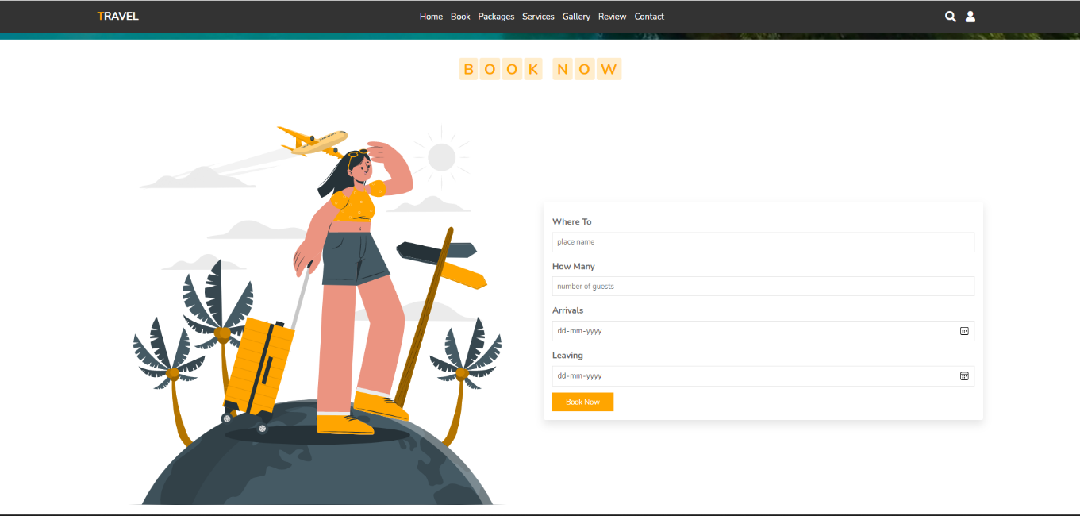
Output Screen

Slide 7
CONCLUSION
Travelers continue to seek authentic experiences. The tools they use to research and book these experiences are constantly changing due to innovations in technology. Destinations are also challenged by limited financial resources and strong competition for tourist from other iconic and even lesser-known locations. The personalization of travel suggests that independent travel will have a stronger presence than group travel, however, we must always consider the type of traveler. The travel services sector is being forced to innovate at a startling rate.
In the past, face to face consultations with a travel agent was paramount for booking both leisure and business travel. Technology and global circumstances, such as pandemics, financial collapses, and terrorism, have put pressure on tourism and travel services.
Concluding on the note that this website will help traveler in having a memorable and amazing solo or group trips.

